Slide 1
Python Modules
A module is a .py file containing definitions and statements. So all .py files that we created so far for our programs are module.
When we execute a program its module name is __main__. This name is available in the special variable __name__.
import keyword is used to import module.

Slide 2
Uses of Modules
It makes sense to split a big program into multiple .py files. Where each file acts as a module. Therefore, It facilitates ease of development and maintenance.
We can keep common function in separate module so that other module can use it.As a result we can reuse the existing code.

Slide 3
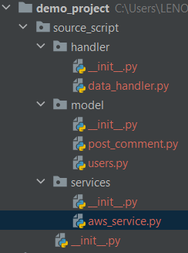
Python Packages
A python package is a collection of modules.
A particular directory is treated as a package if it contains a file named __init__.py in it.
The directory may contain other sub-packages and module in it.

